Slide 1
Introduction to Containers
Lunch and Learn

Slide 2
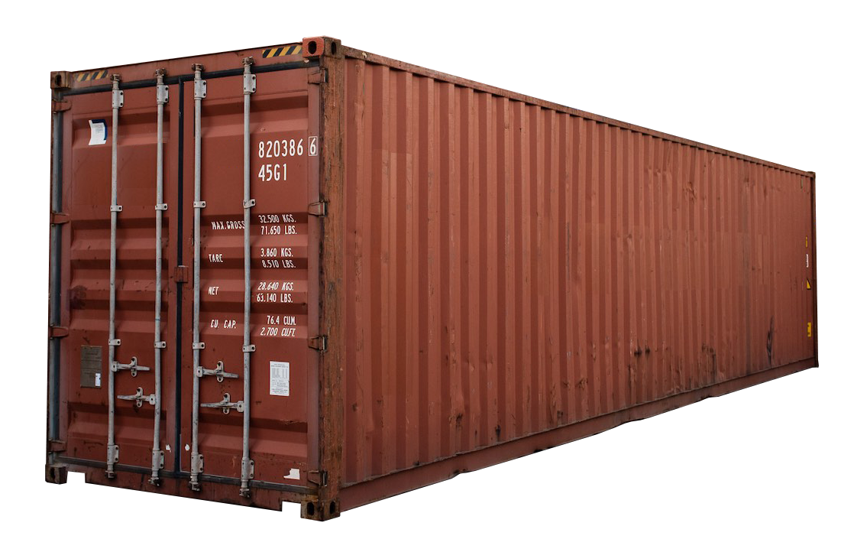
What are Containers?
Notes:
Way to package software

Slide 3
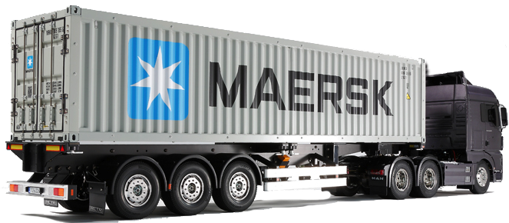
What are Containers?
Notes:
Makes them portable

Slide 4
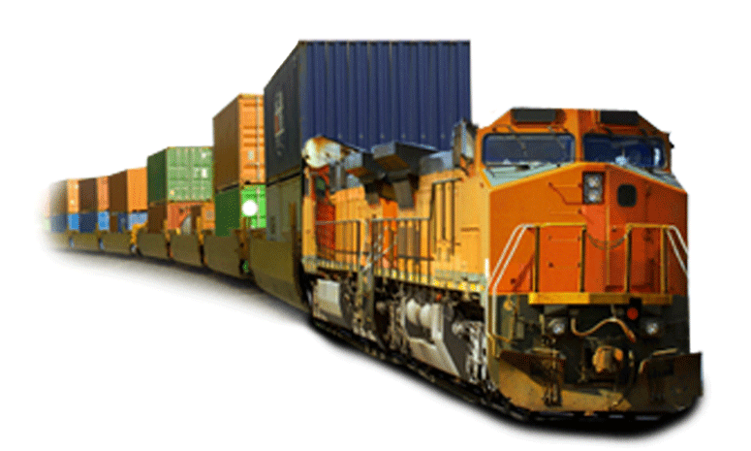
What are Containers?
Notes:
Isolates applications on the same host

Slide 5

What are Containers?
Notes:
Allows applications to share a host

Slide 6
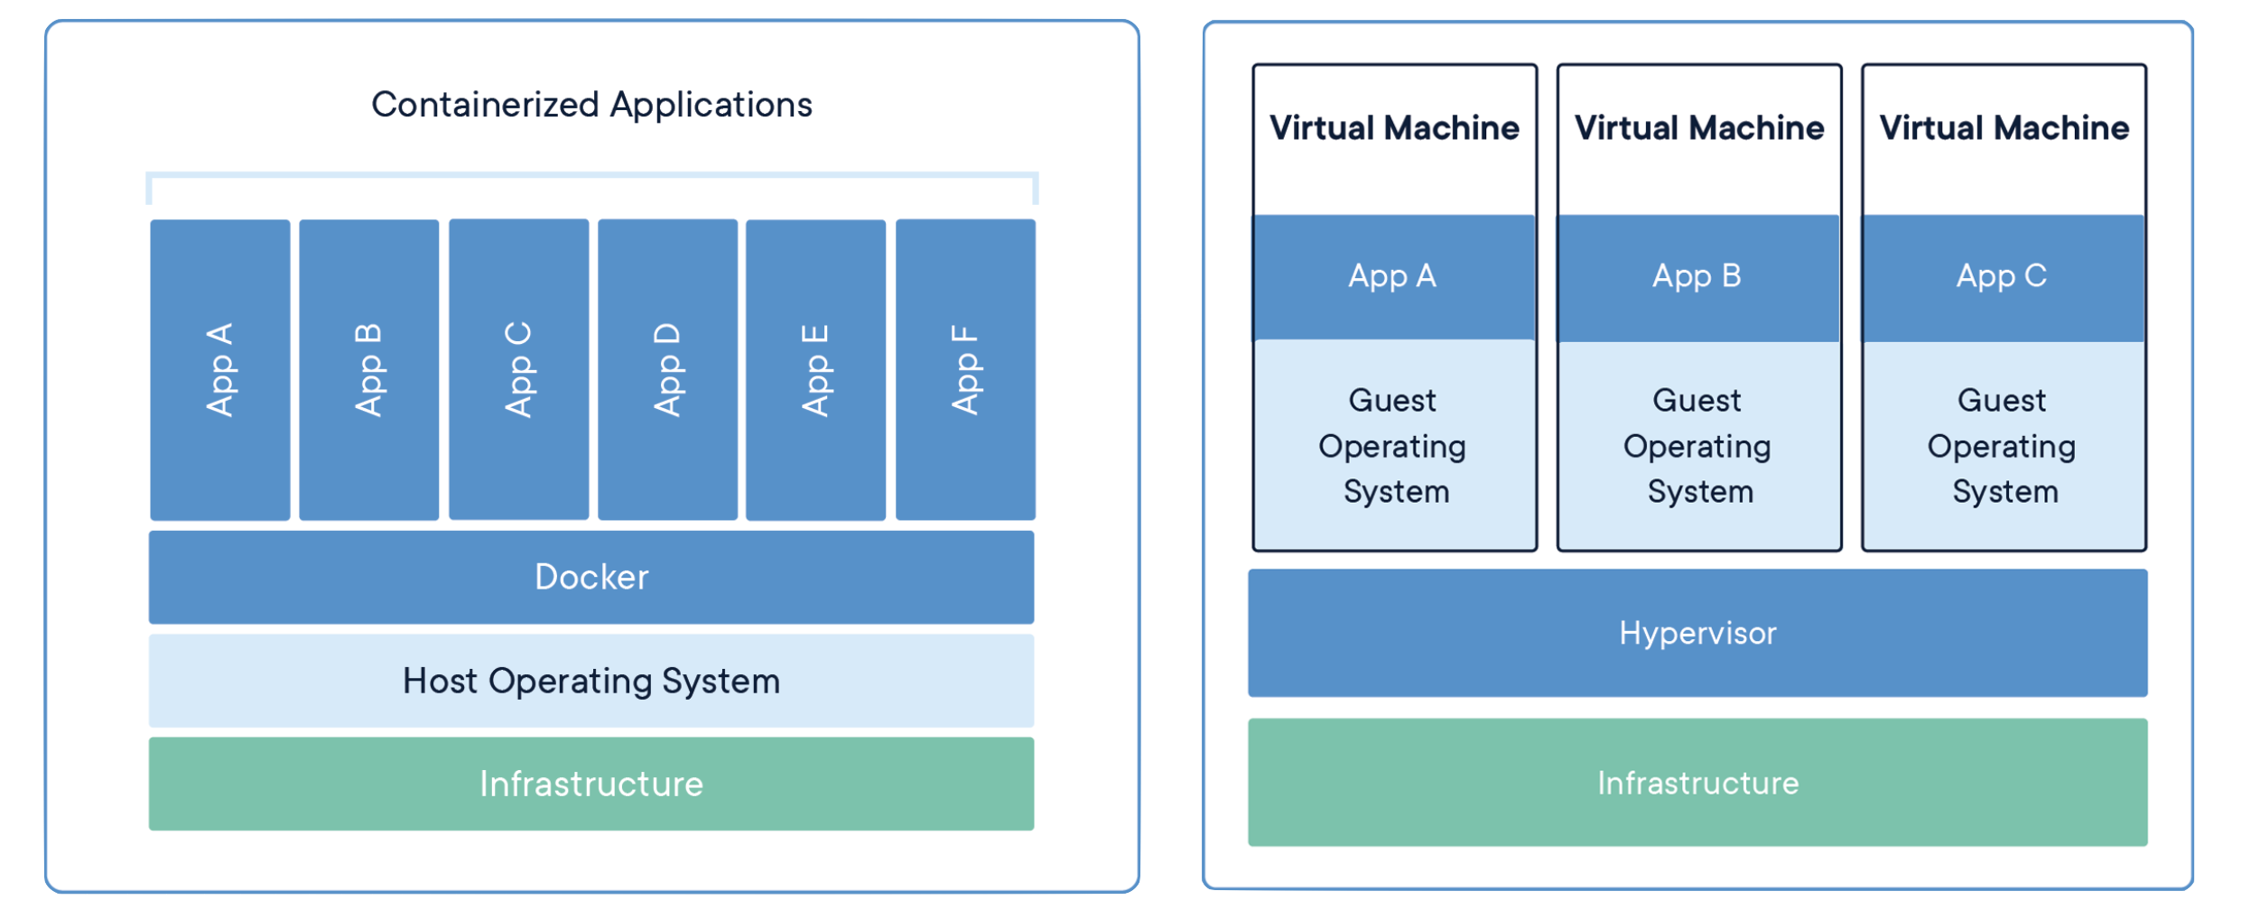
Containerization vs Virtualization (Simplified)
Notes:
Sharing Resources
Sounds a little like Virtualization, how do they differ?
Instead of virtualizing a whole machine and operating system (binaries, drivers, kernel, bios, networking, storage)
The container engine shares the operating system amongst the individual containers

Slide 7
Why are Containers Used?
Notes:
It allows us to package a software and all of its dependencies together.
This allows them to be extremely portable and able to run basically anywhere with a container engine.
Allows for greater server density
Allows for Application Isolation
Allows for quick scaling of applications
Fast, Lightweight, Portable

Slide 8
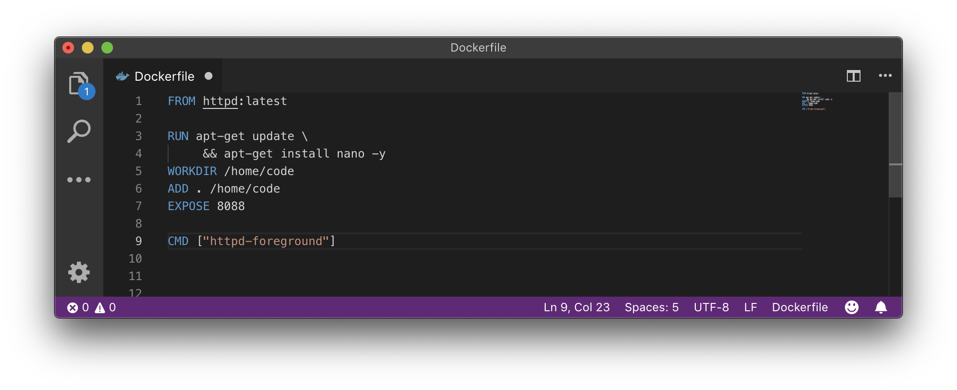
Dockerfile
Notes:
How an application is packaged with its dependencies and built.
Discuss layering

Slide 9
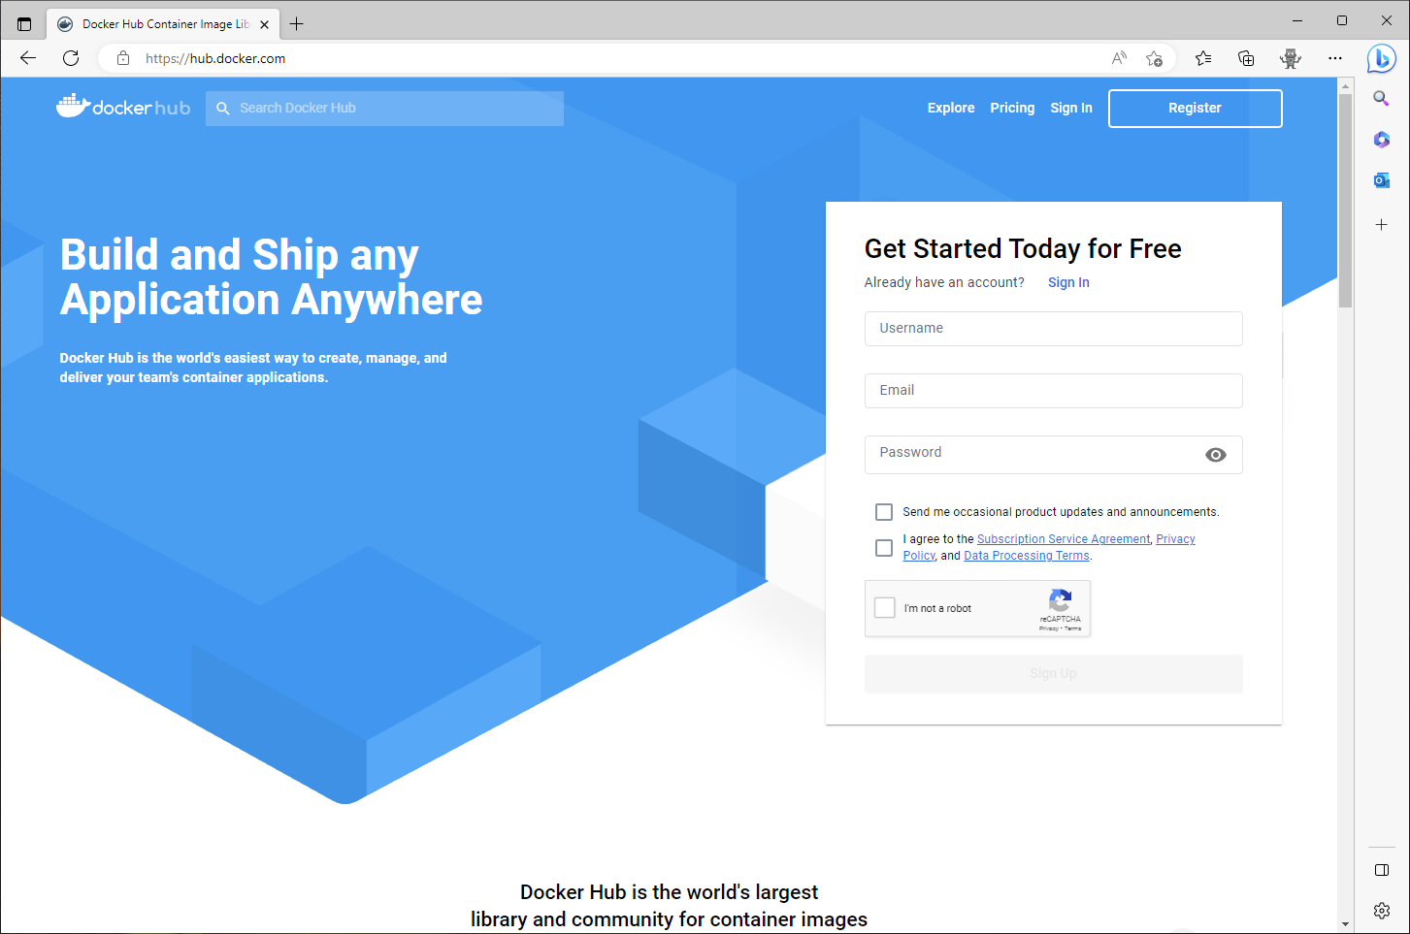
Container Repository
Notes:
https://hub.docker.com/_/httpd

Slide 10
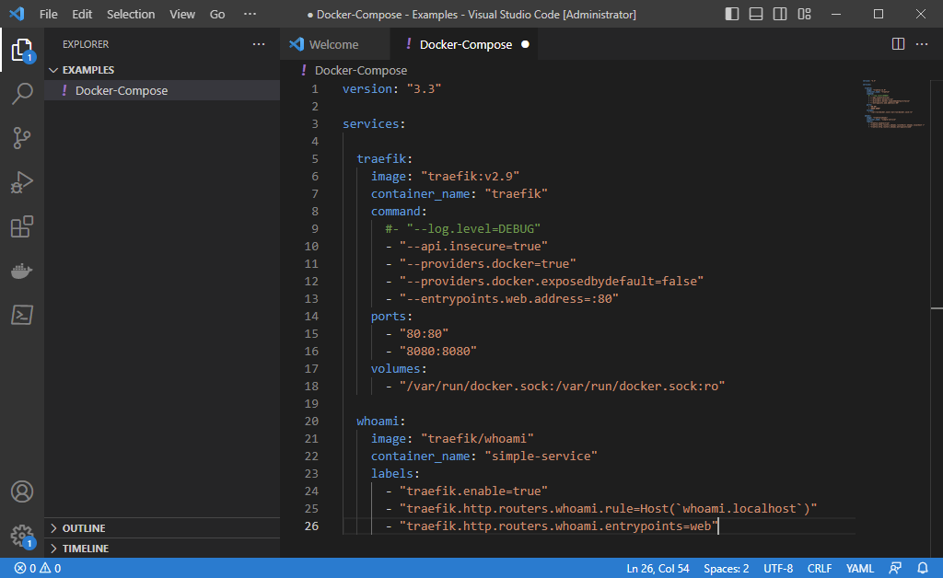
Docker Compose
Notes:
A tool for defining and running multi-container Docker applications. It uses a YAML file to configure the application’s services, networks, and volumes.

Slide 11
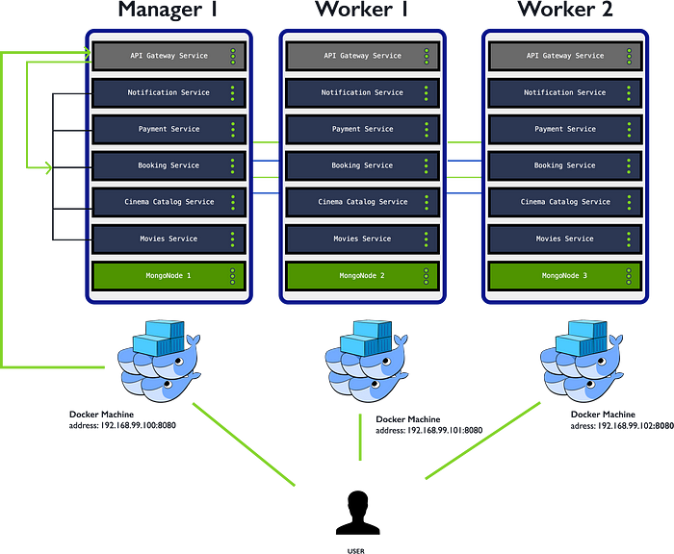
Docker Swarm
Notes:
Docker Swarm is a tool for managing a cluster of Docker hosts. It allows you to create and manage a swarm of Docker nodes and schedule containers to run on the swarm. In simple terms, Docker Swarm helps you manage and orchestrate multiple Docker hosts so that you can easily deploy and scale your applications across multiple machines.
Kubernetes is an open-source platform that automates the deployment, scaling, and management of containerized applications. It groups containers that make up an application into logical units for easy management and discovery. In simple terms, Kubernetes helps you manage and orchestrate containers so that you can easily deploy and scale your applications.
OpenShift is Kubernetes platform developed by Red Hat that helps developers build, deploy, and manage containerized applications. It offers automated installation, upgrades, and lifecycle management throughout the container stack, including the operating system, Kubernetes and cluster services, and applications 1. In simple terms, OpenShift is a platform that makes it easier for developers to build and deploy applications using containers.

Slide 12
Demo time!
Notes:
https://labs.play-with-docker.com/

